Slide 1
Task Module API
Developers: Assaf Israel & Eli Nazarov

Slide 2
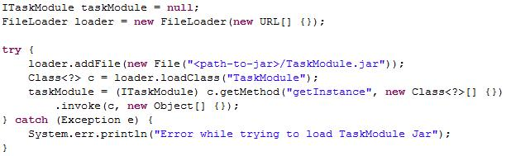
Working Flow - Setup
ITaskModule, IExperiment & IDataModel will be available via Standards.jar
Concrete implementation will be available via a the TaskModule.Jar
Dynamically load jar file to ITaskModule (almost like games)

Slide 3
Working Flow - Overview
You know your program best
Methods/Variables names
Some methods may not exists
Implementation independent
Call it what you want, and let us know when it happens

Slide 4
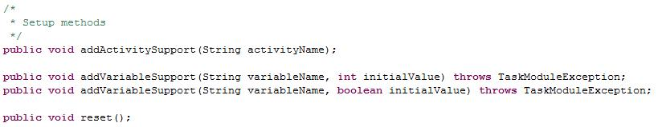
Working Flow - Initialization
Declare and name your “Activities”
Declare and name your Variables
Currently we’re supporting Boolean & Integer var.

Slide 5
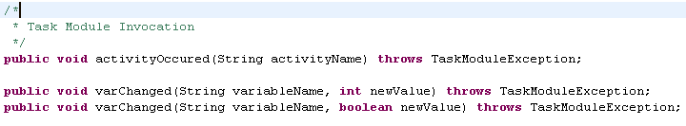
Working Flow – Invocation
You are responsible for letting us know when Activities occur & when Variables change.

Slide 6
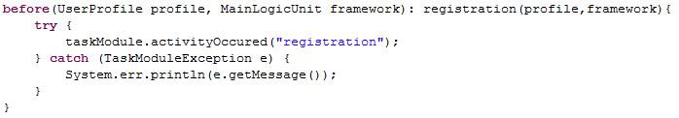
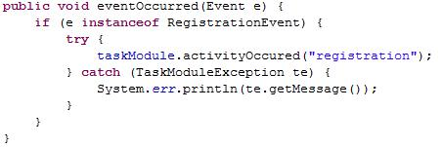
Working Flow – Invocation
AspectJ
Events

Slide 7

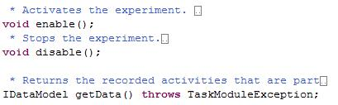
Working Flow – Management
Tasks are compiled ConGlog scripts
Experiments are smart Task containers
Serves as a Set of Tasks
You can Enable/Disable Experiment recording

Slide 8
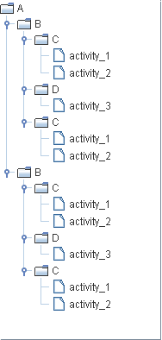
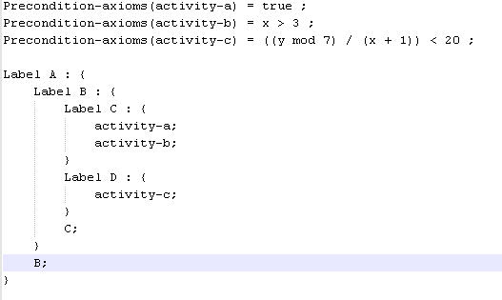
Working Flow – Compiler
Task Creation
ConGlog scripts are compiled to Tasks
ConGlog Script

Slide 9
Working Flow – Data
Experiment Management
Experiment recording can be enabled/disabled (via IExperiment interface)
Data Model
Generic storage of data.
Can be exported to CSV file.
Experiment scope.
Task Module scope.

Slide 10
Working Flow – Analyzer
Default Analyzer (via IDataModel interface)

Slide 11
E2E Example
The following example is an end to end simple scenario implementation using AspectJ

Slide 12
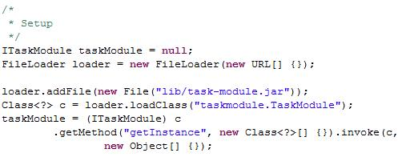
E2E Example - Setup
task-module.jar has been put in lib folder
load the concrete “taskmodule.TaskModule” class
Interfaces are available via Standards.jar
ITaskModule is design as a singleton, so use “getInstance”

Slide 13

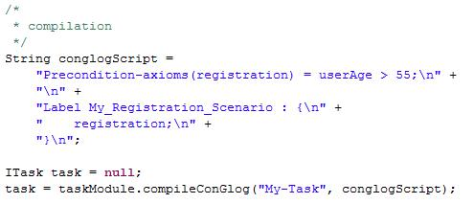
E2E Example – Initialize & Compile
We’ll demonstrate a simple registration scenario
The following script, checks if the user age is above 55

Slide 14
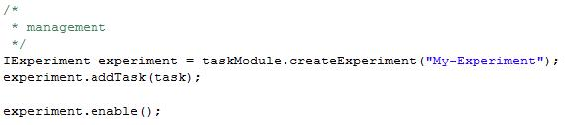
E2E Example – Experiment
We’ll create a new experiment with the compiled task and enable the recording for it.

Slide 15
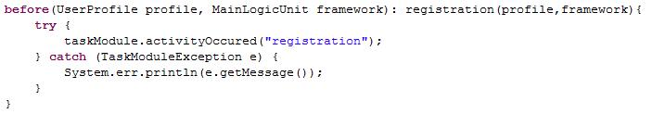
E2E Example – AspectJ
Registration pointcut
Registration advice

Slide 16
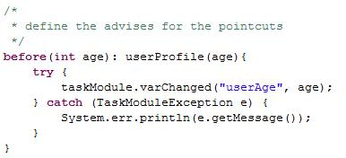
E2E Example – AspectJ Cont.
User age pointcut
User age advice

Slide 17

E2E Example – Analyze
After we’ve played a bit with the system, we’re ready to get the results
Export them to a file

